Slide 1
Chiba campaign 2022
DAI YAJIE
Date：2022/12/1
Report date 2022/11/30

Slide 2
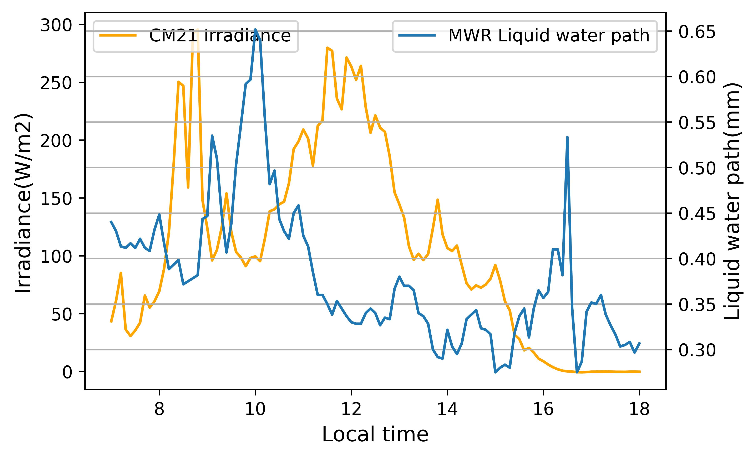
Solar radiation
2022/11/30
Cloudy
Sunrise time：6:31
Sunset time：16:26
RainFlag: 7:00-7:30

